Slide 1

Your First Preliminary Hearing
Presented by Sarah Fountain
Guest Crown: Rob Wadden
MCM #38
August 7, 2013

Slide 2
Sarah’s First Prelim
Sarah Fountain
Robert Wadden

Slide 3
Chapter 1
Sarah gets a file

Slide 4



WTF??
Break and Enter
to a residence
while occupied

Slide 5

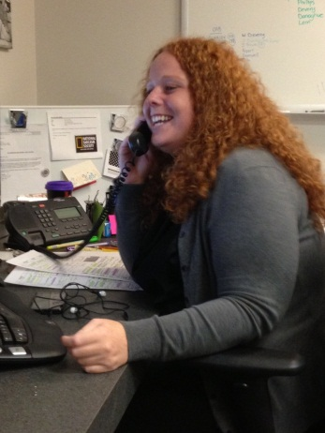
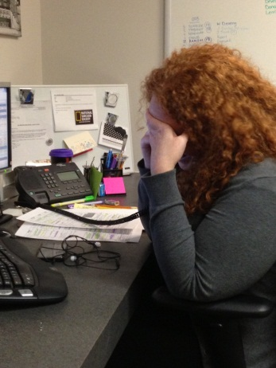



WTF?

Slide 6
Procedure
See flow chart: PM [2004] No 7 – Attachment #1
We should consider requesting a prelim if:
  The case is serious and complex
    It may assist in making decisions about RPC and/or appreciate evidence of essential witnesses
    You can call a co-accused or relative of the accused (ie. YP co-A at adult PH)
  There is a need to preserve evidence
    The old, young, sick, transient etc.
    Those likely to change evidence later or become more hostile/adverse or at risk of retribution

Slide 7
Procedure
Important tips:
Consider requesting a focus hearing if defence counsel is insisting on the equivalent of a full trial (s. 536.4)
    Make sure the judge records any admissions (s. 536.5)!
2. Don’t forget about reasonable notice requirements under s. 540(7)
3. Evidence admitted under s. 540(7) cannot be read in at a subsequent trial pursuant to s. 715(4)
Notes:
R 4.3 party who requests PH shall serve statement of issues and witnesses with proof of service 3 days before hearing – difficult rule bc it hinders ability to request focus hearing if there is a disagreement – suggestion to contact counsel beforehand

Slide 8
Preliminary Hearing??
Your Hurdle: The Sheppard Test
Your Goal: Don’t f@#& it up for the ACTUAL trial (committal, etc.)
Your Key to Success: Preparation (or a Senior Crown, if possible)

Slide 9
Your Hurdle
Q: Is there any evidence upon which a reasonable jury properly instructed could return a verdict of guilty?
United States of America v Sheppard, [1976] SCJ No 106
The question “is not whether there is a reasonable prospect of conviction, or whether a conviction based on this evidence would...be reasonable or supported by the evidence...[t]he test is simply whether the evidence meets the test of Sheppard.”
R v Walizadah, [2002] OJ No 2833 (SCJ) at para 15; aff’d [2002] OJ No 5451 (CA)

Slide 10
Your Hurdle: Conceptualizing Standards
Sarah’s Continuum*
Sheppard < RPC < BARD
*very likely discussed elsewhere by someone citable but if I don’t check, it’s my idea

Slide 11
Your Hurdle: Direct Evidence
Provide evidence on each element
No weighing credibility
No weighing reliability
Contradictions from defence evidence do not matter
Even recants don’t matter!
R v Arcuri, [2001] SCJ No 52 at paras 22, 29
Walizadah, supra at para 19
Notes:
Recants: wazalidah at para 19
A jury is entitled to accept and act upon some, all or none of what a witness says. There is no magic in the fact that the “exculpatory” evidence came later in Nafisa’s testimony or “at the end of the day”. The jury is not obliged to prefer the latest story and reject the earlier story. It is open to the jury to prefer the earlier story. [Emphasis added].

Slide 12
Your Hurdle: Circumstantial Evidence
You do not have direct evidence on one or more elements of the offence…what now?
The test remains the same
The question now becomes whether that missing element can be reasonably inferred from the circumstantial evidence
The judge is required to engage in some weighing of the evidence to determine if there is ANY evidence

Slide 13
Your Hurdle: Circumstantial Evidence
- The inference must be reasonable and logical
  The fact that an inference may be difficult to draw does not mean that it cannot be drawn
  R v Katwaru, [2001] OJ No 209 at para 40 (CA)
- If there are competing inferences, the judge must accept the inference most favorable to the Crown
R v Masterson, 2008 ONCA 481 at para 6
It is a cumulative effect of all of the evidence, not individual pieces of CE
R v Vanderburg, [2004] OJ No 5843
Notes:
Masterson - Crown relied on evidence of motive, opportunity, forensic evidence and after-the-fact conduct to implicate the respondent as Godin's killer
In deciding that issue, the trial judge was to take the case for the Crown at its highest and in doing so, it was incumbent upon him to resolve competing permissible inferences in favour of the Crown. That he did not do. On the contrary, he addressed the evidence on a piecemeal basis, weighed the various inferences individually and ultimately resolved them in favour of the respondent as opposed to the Crown.

Slide 14
Chapter 2
Rob and Sarah work
on the file

Slide 15


Slide 16
Witness: Victim
Witness: Eyewitness
Identification Officer
and Photos
Admission at PH
Police IA’s and Will States
Not Needed at PH

Slide 17
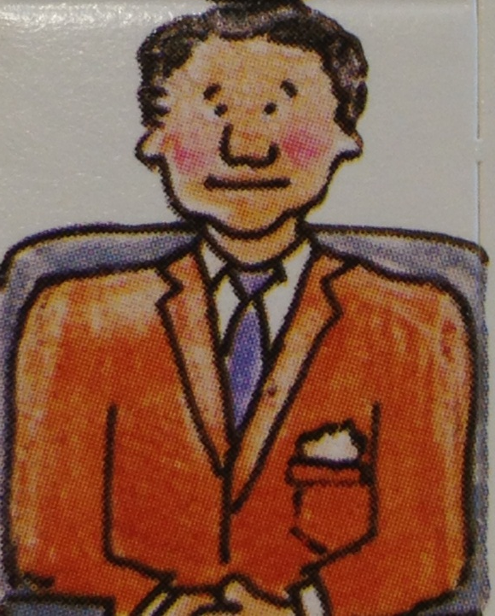


Slide 18


Slide 19
Your Goal: Preparing for Committal
Step 1: What are the charges?
  Can I proceed on all of the charges?
    Hybrid and absolute jurisdiction offences can go up but straight summary cannot
    Strategy: Pursue FTC/FTA?
  Am I stuck with the charges on the information?
    s. 548 – if evidence of another indictable offence emerges from facts in respect of the same transaction, the PH judge can order the accused to stand trial on those in addition to counts on the information
    s. 574 – same as above but WE can do it, even if PH judge declines (only for NEW offences, not those contained in the information)
    Also think about changes to the language (ie. particulars)
Notes:
Cause disturbance 175
Take motor vehicle without consent 335
Keeping gaming or betting house 201
372(2)(3) – not (1) – indecent or harassing calls
Falsifying employment record – 398
Personation at school exam – 404
Get Waddy to explain preferring indictment under s. 577 (direct indictment)

Slide 20
Your Goal: Preparing for Committal
Steps 2/3: Do I have evidence on each element of each count? What is the best way to present it?
  Strategy: Where do I draw the line on calling evidence? How many witnesses are too many?
  What if defence wants to hear from someone I don’t need? (from statement of issues)
  Should I use s. 540(7)?
Notes:
Strategy – discuss!
If they want to hear from someone you don’t need. Focus hearing – if no time, too bad – no right to discovery, they have disclosure

Slide 21
Your Goal: Preparing for Committal
  s. 540(7) – the PH judge can receive otherwise inadmissible evidence if it is credible or trustworthy
    Must provide reasonable notice of intent to use [s. 540(8)]
    Can be written, video, audio – formal is best (signed etc)
    R v McCormick, [2005] OJ No 390 at paras 13-21 (CJ)
    Our onus to prove it is credible & trustworthy
      not as high as KGB standard; prima facie air of reliability
      R v Francis, [2005] OJ No 2864 (SCJ); R v Pinnock, [2004] OJ No 3692 (CJ)
      Must call someone to establish this, for eg. Officer who took the statement or other corroborative evidence
      R v Trac, [2004] OJ No 5469 (CJ)
    Eg. Pinnock vs. McCormick – you may have difficulty if your witness is a nightmare
Notes:
R. v. Pinnock, above, at paras. 10-13
Some factors that made this case a Crown nightmare were:
the witness, in essence, resiled from his statement, or significant aspects of it, in his preliminary inquiry testimony;
the witness had a record for offences of dishonesty;
the witness tried to repudiate statements to police;
the witness had not been candid with police;
the witness had attempted to hold the investigation hostage by promising police information, if they would help him deal with C.A.S. issues;
the witness admitted to lying under oath in a KGB statement.
Contra, see R. v. McCormick, above, para. 35, in which Dobney J. was of the view that such factors should still be left for the jury, and that the test at preliminary inquiry involved “circumstantial indicia of reliability”.

Slide 22
Your Goal: Preparing for Committal
  Don’t forget about s. 540(9)!!
  s. 540(9) – the PH judge can require your witness to attend for cross-examination
    The test is low and the order discretionary: “appropriate” persons
    Francis, supra at para 34 (SCJ)
    If we can’t produce the person and the PH judge finds that it is appropriate a witness be made available for cross, it may not go in
    McCormick, supra at para 46
    Unusually vulnerable witnesses may get a pass
      Health reasons; Extended absence, deceased, very young (to spare testifying twice)
      R v Roth, [2006] OJ No 1900; McCormick, supra at para 47
      Or not…6 year old child ordered to appear for cross as no psychological or emotional trauma or undue harm
      R v CM, [2005] OJ No 1071 at para 30 (CJ)
Notes:
McCormick – in ordering that cross is appropriate, the judge relied on the fact that there were credibility concerns and valid issues fro discovery – the judge suggested that the crown can bring a Khan
If they are going to be crossed anyway, should you just have them testify? If onside/offside?

Slide 23
Your Goal: Preparing for Committal
Step 4: Do I need to bring/be prepared to respond to any applications?

Slide 24
Your Goal: Preparing for Committal
The PH judge has jurisdiction to deal with these:
  Material Witness Warrants [s. 705]
  Hearsay*
  Expert evidence [s. 657.3]*
  Voluntariness
    Crown must still prove voluntariness BARD to adduce the statement of the accused [s. 542]
  New disclosure – defence adjournment applications
  Privilege
  Khan application
  Similar Fact Evidence [eg. R v Burstein, [2006] OJ No 989 (CJ)]
  Sexual History [s. 276] [eg. R v VD, [1999] OJ No 4922 (CA)]
  9(2)*
  *always remember s. 540(7) as an option

Slide 25
Your Goal: Preparing for Committal
The PH judge does not have jurisdiction to deal with these:
  Third Party records (O’Connor & s. 278.1-278.9)
    Defence can ask about the existence but not the content
    R v EB, [2002] OJ No 75, aff’d [2002] SCCA No 94
  Charters
    Court can’t order a stay or exclusion of evidence
    R v Mills, [1986] SCJ No 39
    Defence can ask questions about the issues surrounding them
    R v George, [1991] OJ No 1704 (CA)

Slide 26
Chapter 3
Off to Court

Slide 27
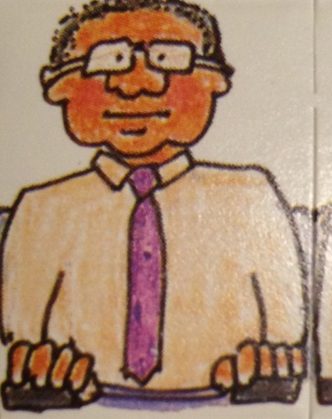
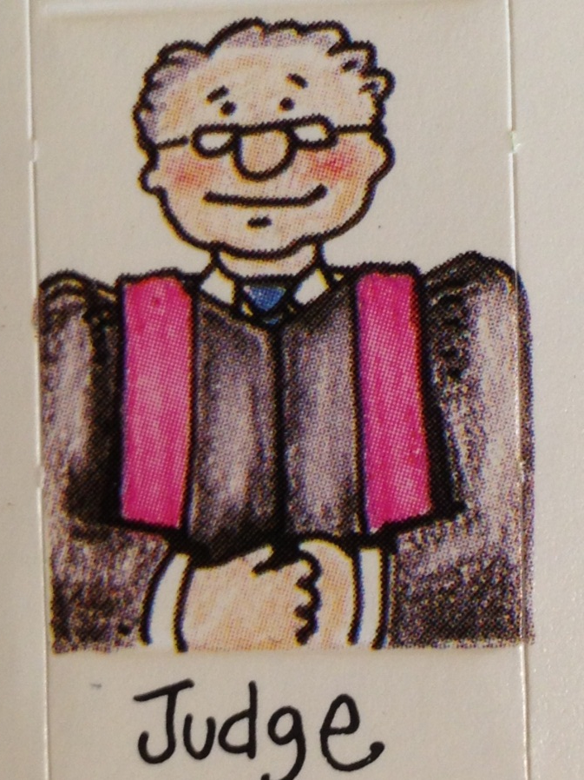



Admissions

Slide 28

Committal on
s. 348 B & E (as charged)
s. 349 Unlawfully
in a Dwelling
(additional count,
not on the information)

Slide 29

WTF?

Slide 30
Your Goal: Committal
Step 5: Present your evidence and argue committal!
  Keep your ears peeled for the ultimate defence(s)
  Assess your opponent’s style to prep witnesses for trial (especially if there are co-accused – order of indictment)
  Be prepared to argue extra counts if discovered (ss. 548, 574)

Slide 31
Chapter 4
Off to SCJ

Slide 32
Forms
Indictment
PH Report
SCJ PT Report
Assignment Court Memo

Slide 33
Forms
The indictment
- check the wording & spelling
- make sure new charges have been added
- discharged counts have been removed
- consider removing breaches
- consider removing counts
to simplify the indictment

Slide 34
Forms
The PH Report
- internal (ie work product privileged)
- assessment of the strength of the case
- appropriate resolution position
- trial readiness
    Witnesses to call
    Length of time for trial
    Status of videos, transcripts, etc
  - Prepares the file so anyone can run it

Slide 35
Forms
The SCJ PT Report
- prepared for the PT and Trial Judge
- much information is from defence
- often prepared jointly with defence
- sets out expected trial issues
    Number of witnesses
    Length of trial
    Whether similar fact evidence
    Whether statement will be run
Notes:
Many answers may be unknown to
Crown before PT

Slide 36
Forms
Assignment Court Memo
    - give Sandy dates for PT’s
and trial availability

Slide 37
Important Dates
Assignment Court
SCJ PT
Trial Readiness Form due date
Trial Readiness Court

Slide 38
Fun Facts
If jointly charged and one accused wants a PH, everyone gets one! [s. 536(4.2)]
PH judge can permit the accused to leave [s. 537] AND if he absconds, PH judge can draw an adverse inference regarding his absence [s. 544]
If a witness refuses to testify, the PH judge can a warrant to have that person jailed for 8 clear days or a lesser adjournment unless there is a reasonable excuse [s. 545]
A judge can convert a trial of an indictable offence to a PH before defence evidence [s. 555]
Notes:
s. 555 – if evidence discloses a more serious version of events, ie. Testamentary instrument involved (2)

Slide 39
Re-Election
s. 561 – Accused can re-elect anytime with our consent (Crown discretion reviewable only for abuse of process)
  If we do not consent, there are limits:
    Judge and jury to Judge alone or vice versa = has up to two weeks post-prelim to re-elect
    OCJ to SCJ(no prelim) or vice versa = has up to two weeks before the trial date to re-elect
    Notice must be in writing

Slide 40
Appeal?
Extraordinary remedies required: certiorari
  Defence can apply to the SCJ to have the committal quashed
  We can also but it is trickier in that we must characterize the error as jurisdictional
    Is the failure to consider the whole of the evidence a jurisdictional error?

Slide 41
What Sarah and Rob Learned

Slide 42
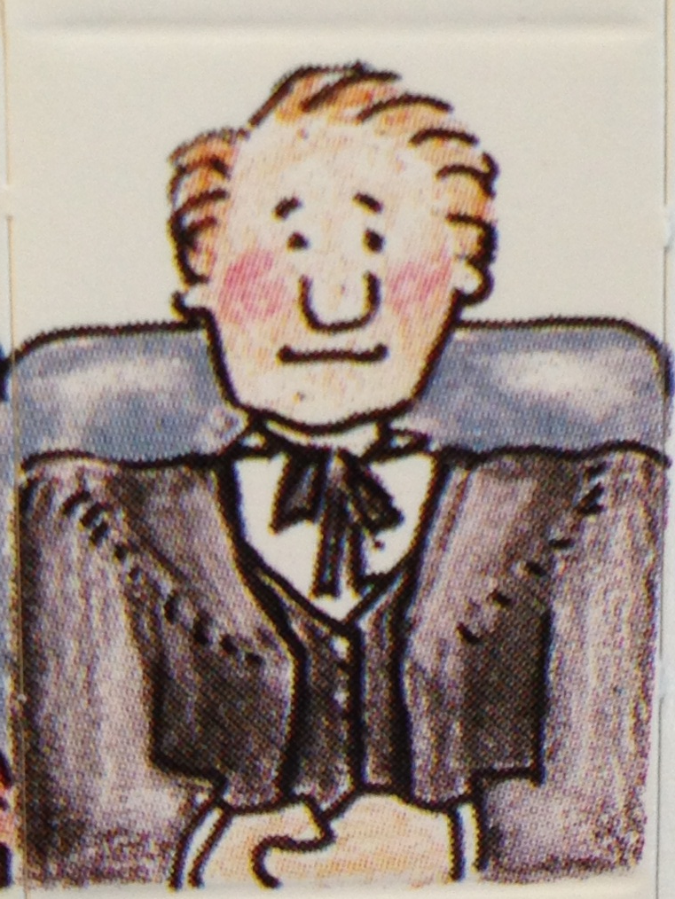
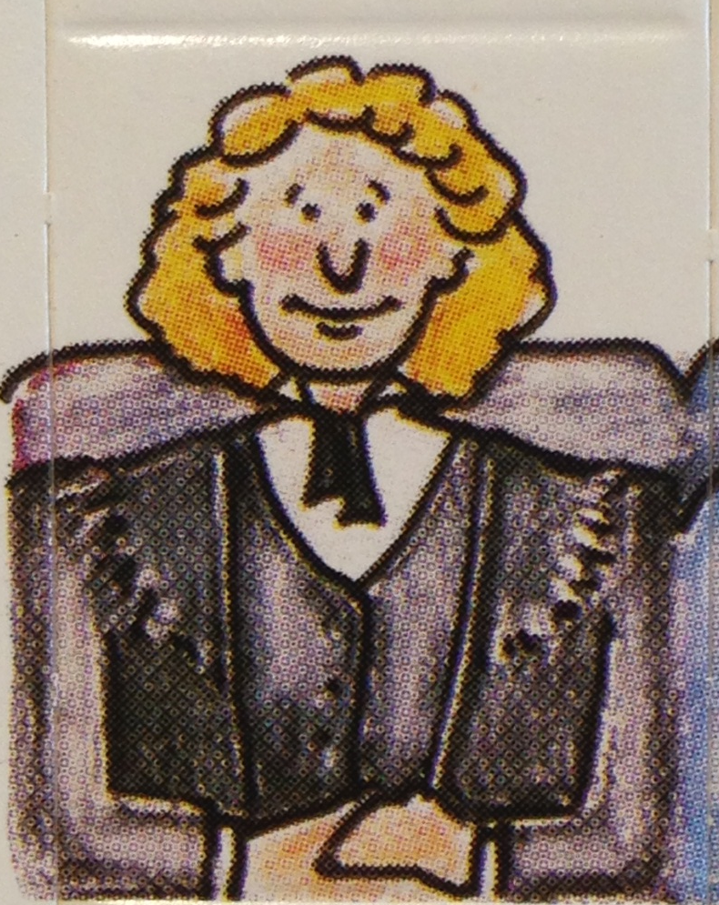

Slide 43
Thank you!!
Waddy – for enlightening us
LTM – for her memo on committal which was plagiarized without shame
MGM – for the slightly offensive artwork
The Criminal Code
CLDNet
Y’all – for listening ☺

