Slide 1

Disorganization
Lack of Clarity
High Standards
Great Expectations

Slide 2
Declutter

Slide 3
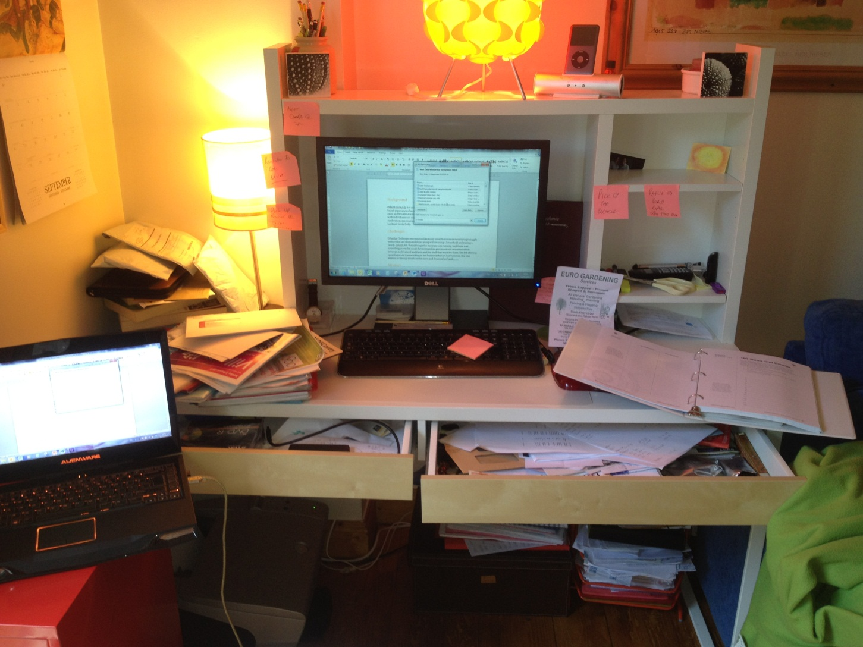


Slide 4
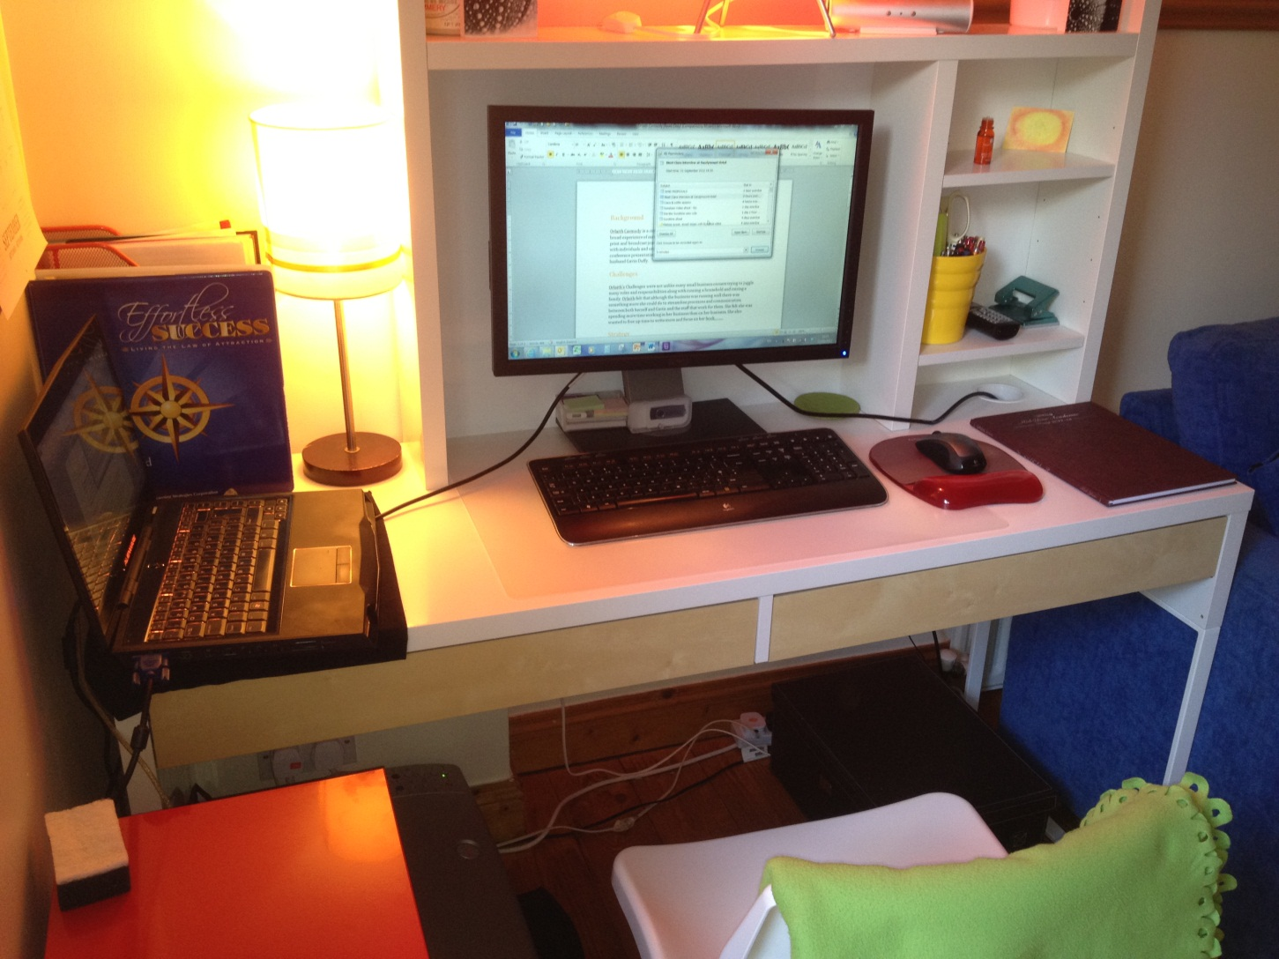

Slide 5


Out of Your Head

Slide 6
Declutter
Work on System

Slide 7

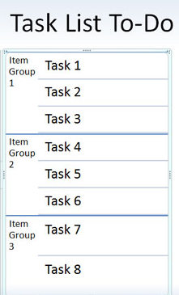

Work on System

Slide 8
Declutter
Work on System
Reassess Goals

Slide 9


Slide 10
Declutter
Work on System
Reassess Goals
Decide on Priorities

Slide 11

“YOU CAN DO ANYTHING, BUT NOT EVERYTHING”
David Allen

Slide 12
Declutter
Work on System
Reassess Goals
Decide on Priorities
Schedule

Slide 14
Declutter
Work on System
Reassess Goals
Decide on Priorities
Schedule
Create Boundaries

Slide 15



Slide 16
Declutter
Work on System
Reassess Goals
Decide on Priorities
Schedule
Create Boundaries
Exercise & Relaxation

Slide 17


Slide 18



Slide 19
