Slide 1
Expanding our understanding of the world through pollinators
Useful lessons for all

Slide 2
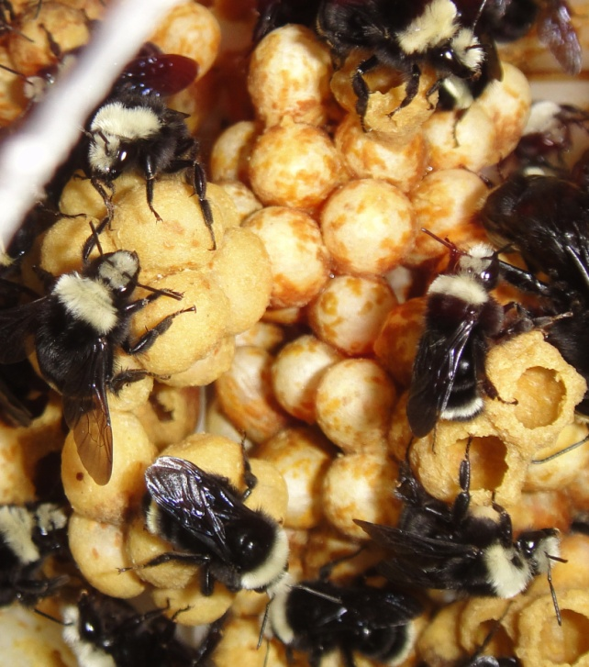
Not BOBs

Slide 3
A disease outbreak in some of our bombus colonies forced us to learn quickly.
First of all about the need for isolation
Also sanitation
and sterilization

Slide 4
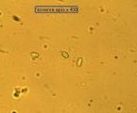
Second, we needed to learn the likely diseases among bombus.
Crithidia bombi
Nosema bombus
Honey bee viruses

Slide 5
With much help from Jamie Strange and Joyce Knoblett at the Logan bee lab, we then learned quickly what it was not.
Crithidia bombi
Nosema bombus
Honey bee viruses
?

Slide 6
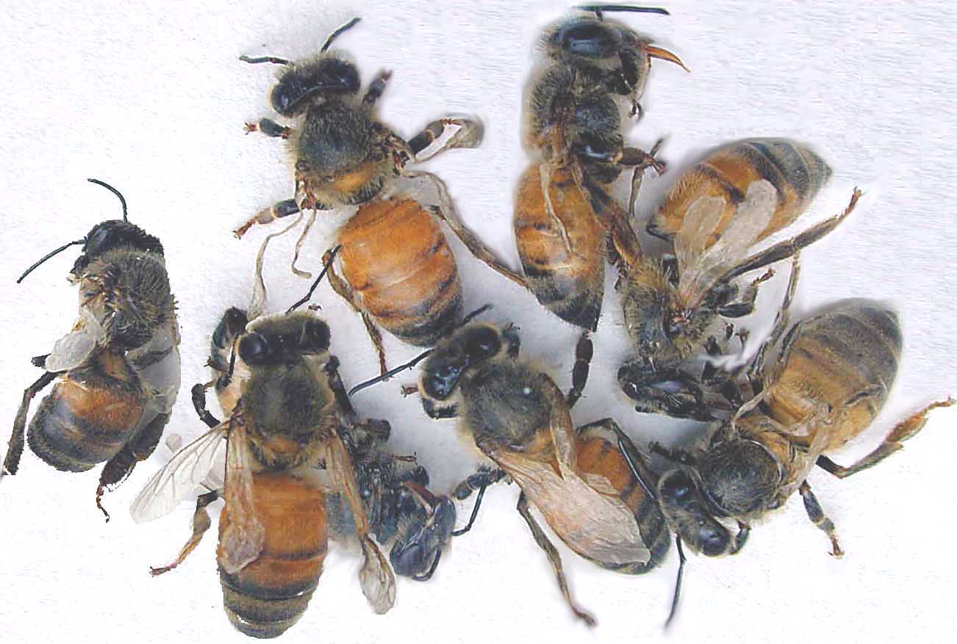
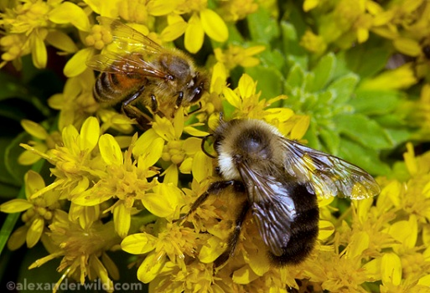
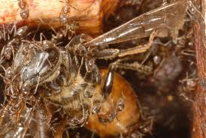
Lessons learned:
Keep things sterile.
2. There are a lot viruses common to honey bees that
(at least) bumble bees are susceptible to –
A. Acute bee paralysis
B. Kashmir bee virus
C. Deformed wing virus
D. Chronic bee paralysis
E. Israeli acute paralysis
F. Black queen cell virus
G. Sacbrood virus
3. All viruses are easily transferred laterally between colonies and species
visiting the same flowers. Even found in ants entering infected hives.
DWV

Slide 7
Questions raised:
What did kill my bees?
(Colonel Mustard, in the bedroom, with the pipe?)
Is it safe to assume solitary species are unaffected by
Honey bee viruses?
Are different bee species (1⁰ bumble bees) more susceptible, Less susceptible, or indifferent to any particular honey bee virus and does it vary by temperature, stage of development, etc.?
Any answers welcome

